Slide 1
Visual Studio Code tips & tricks
Friday seminar
Why it is my favorite code editor

Slide 2
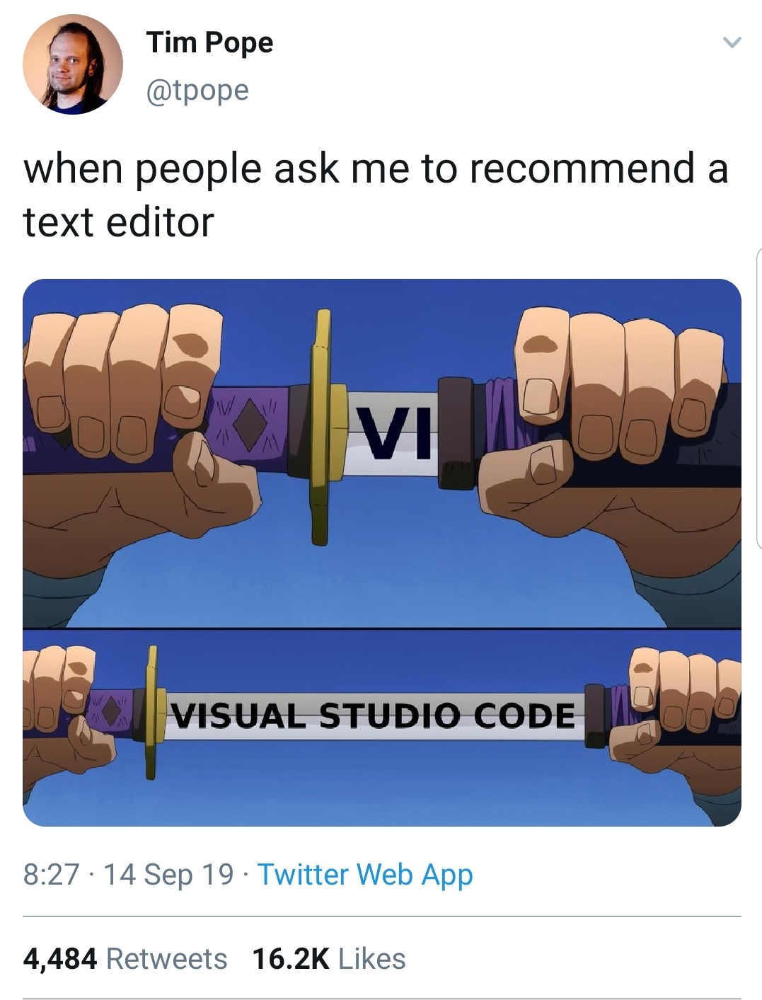

Slide 3

When you first open VS Code

Slide 4
Integrated terminal

Slide 5
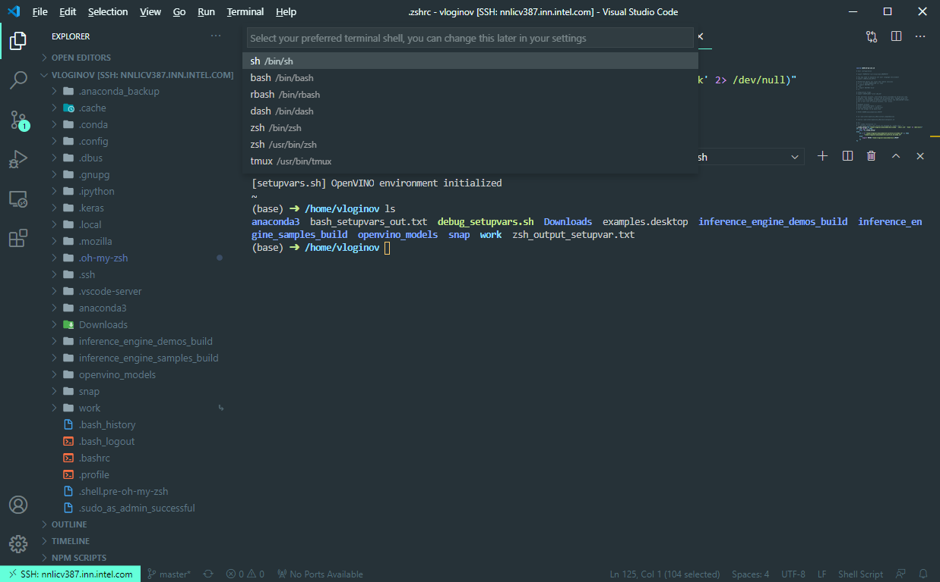
Integrated terminal
Ctrl + ` - show \ hide terminal
Ctrl + shift + ` - new terminal
Custom shortcuts to switch between terminals
Ability to select default shell, including WSL in windows

Slide 6
Git

Slide 7
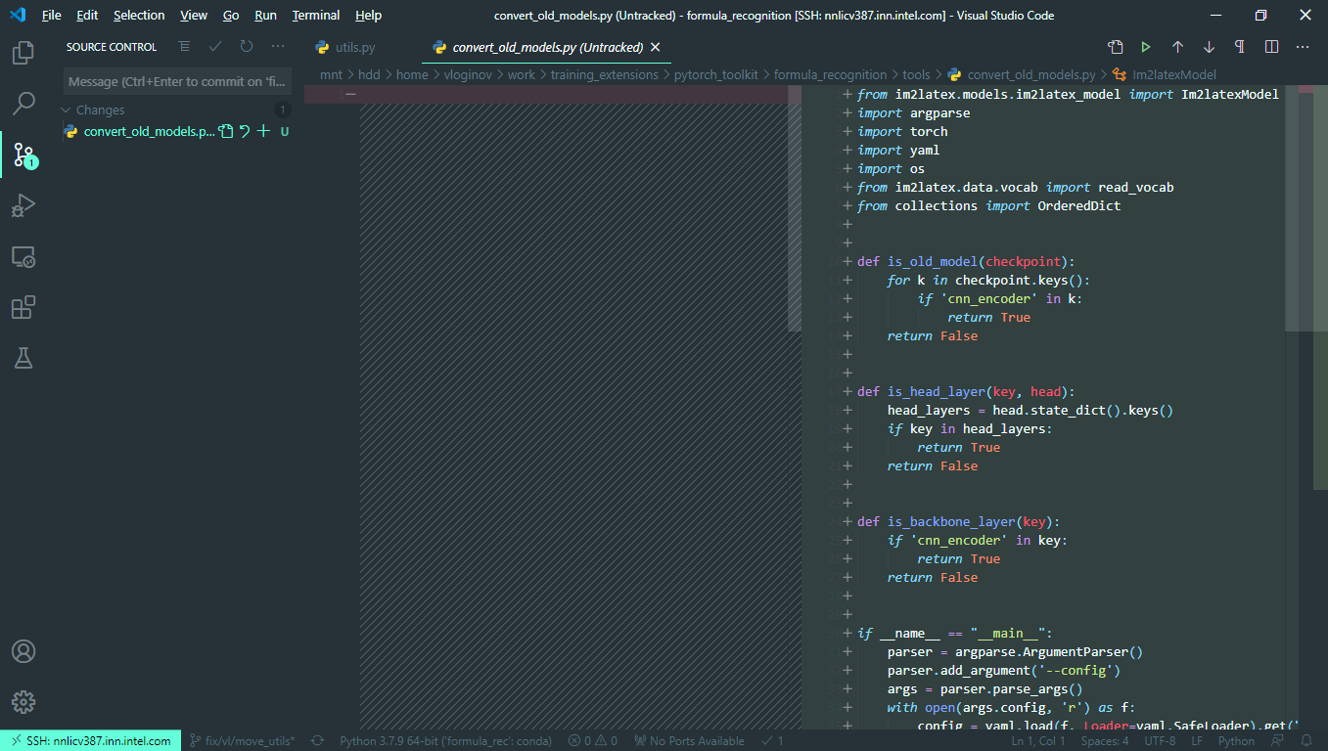
Git
Basic git operations, GUI
Alt + F5 – next change (in split view)

Slide 8
Multirow editing

Slide 9
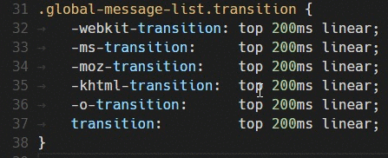
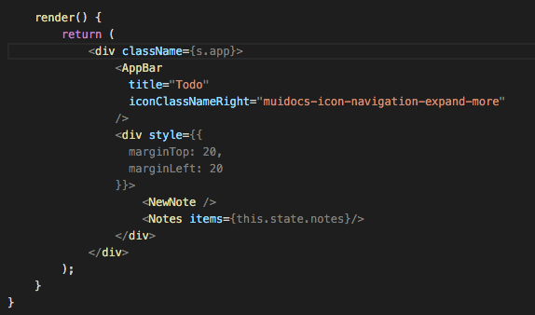
Multirow editing
Ctrl + click to insert extra cursor
Ctrl + alt + down\up to insert cursor
Ctrl + shift + L adds additional cursors to all occurrences of the current selection
Images source: https://code.visualstudio.com/docs/getstarted/tips-and-tricks

Slide 10
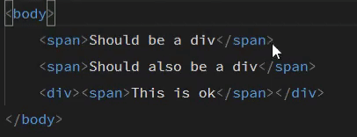
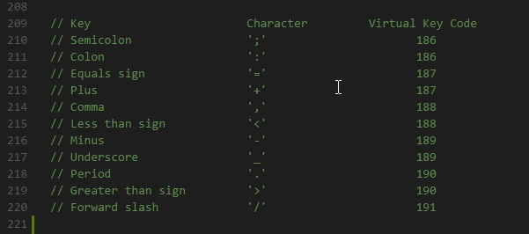
Multi row editing pt 2
Ctrl + D add cursor to the next occurence
Hold Shift+Alt and move cursor to select box \ column
Images source: https://code.visualstudio.com/docs/getstarted/tips-and-tricks

Slide 11
Extensions

Slide 12
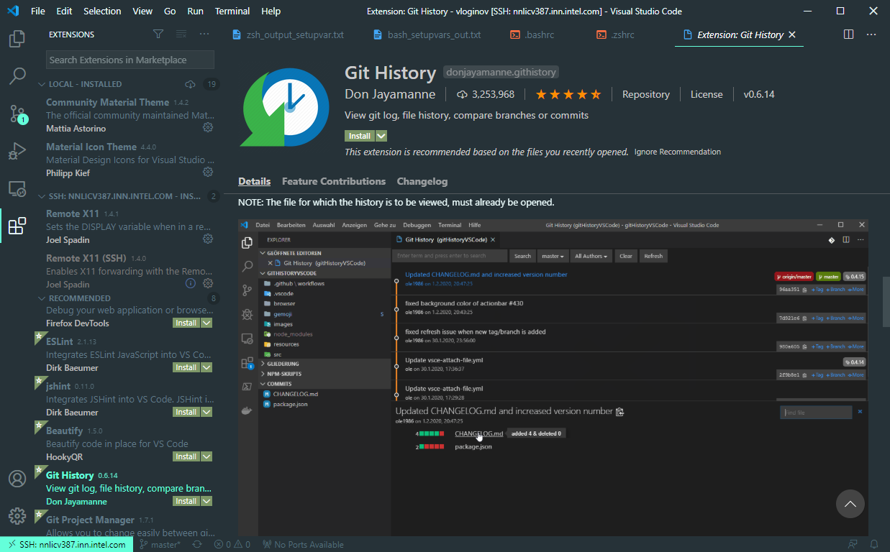
Extensions
Ctrl + shift + X to open extensions marketplace
Extensions could be installed locally, remotely, globally

Slide 13
Synchronization

Slide 14
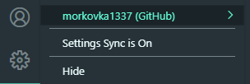
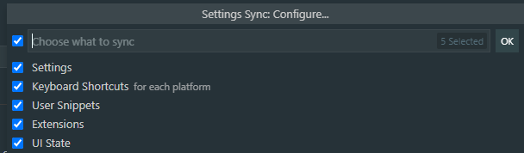
Synchronization
Allows to sync settings, keyboard shortcuts, Extensions, etc
Needs github \ Microsoft account authorization for sync
In case of settings conflict, they can be merged (optionally manually) or replaced
Allows to turn of sync for some extensions

Slide 15
Customization: themes

Slide 16
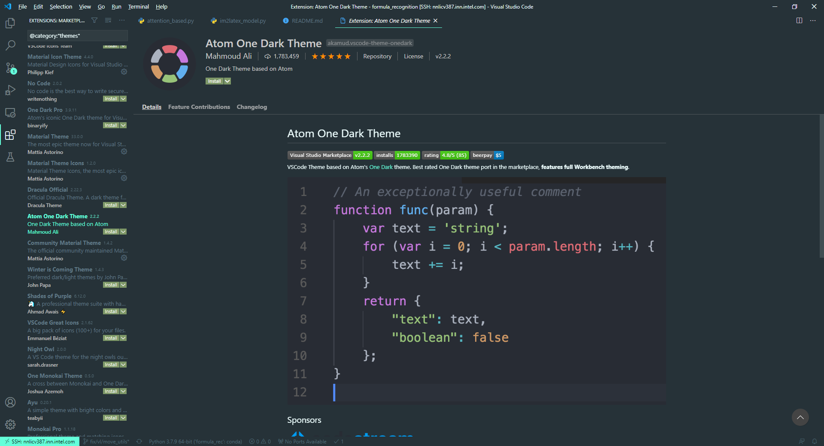
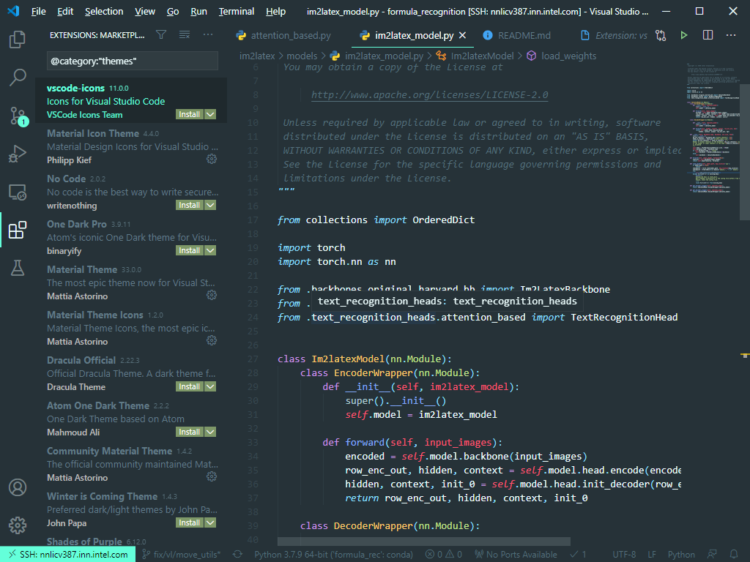
Themes

Slide 17
Custom shortcuts

Slide 18
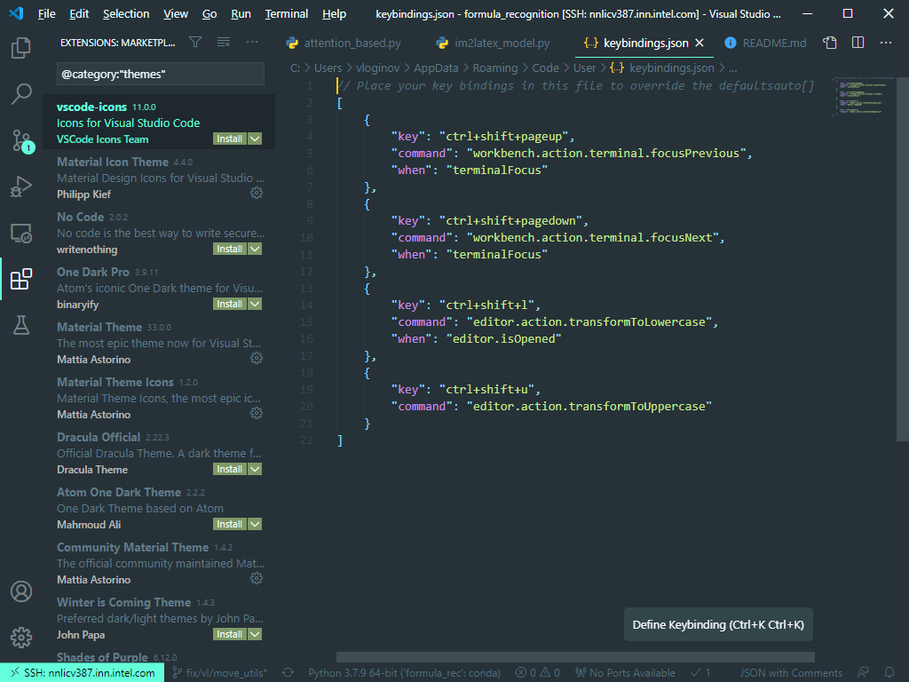
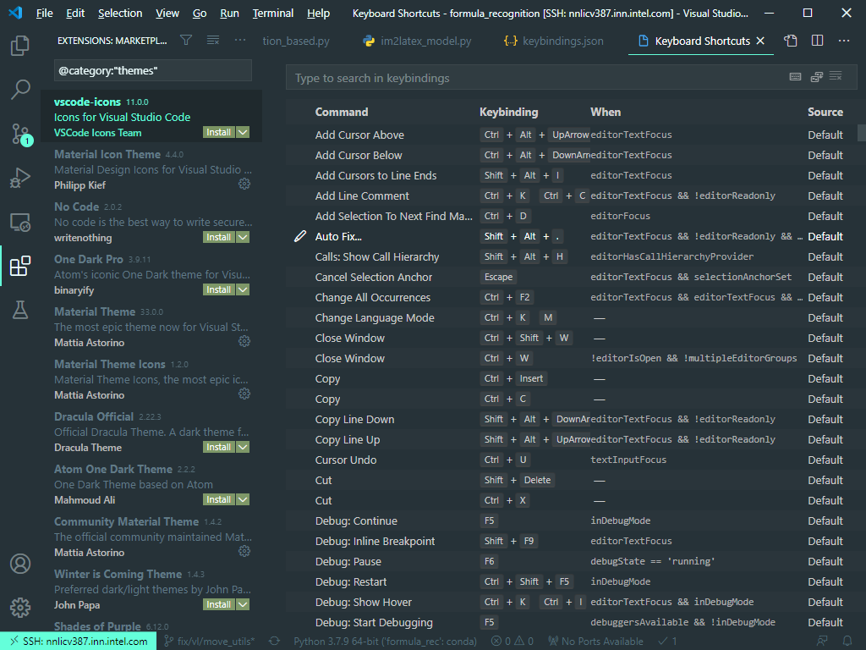
Custom shortcuts
Add your own shortcuts via JSON settings file or via interface

Slide 19
Folder search

Slide 20
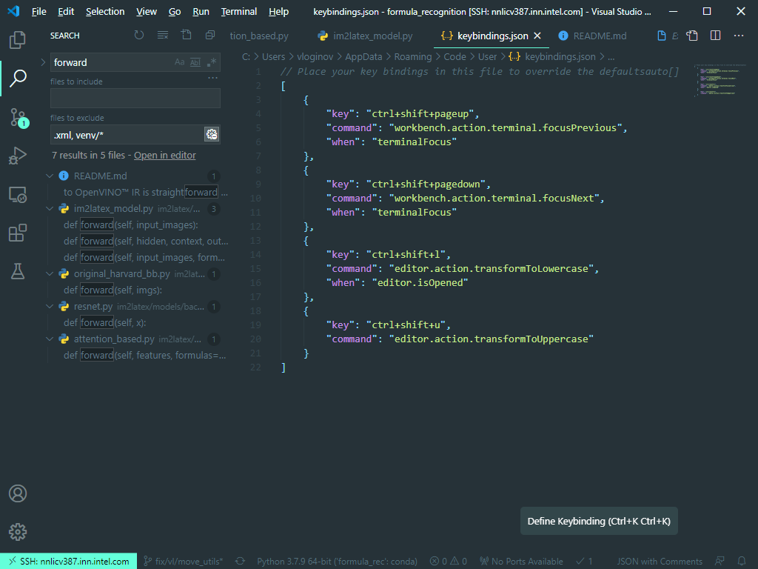
Folder search
Ctrl + shift + F – find in current folder
Filters for files to include\exclude, supports regexp

Slide 21
Tests

Slide 22
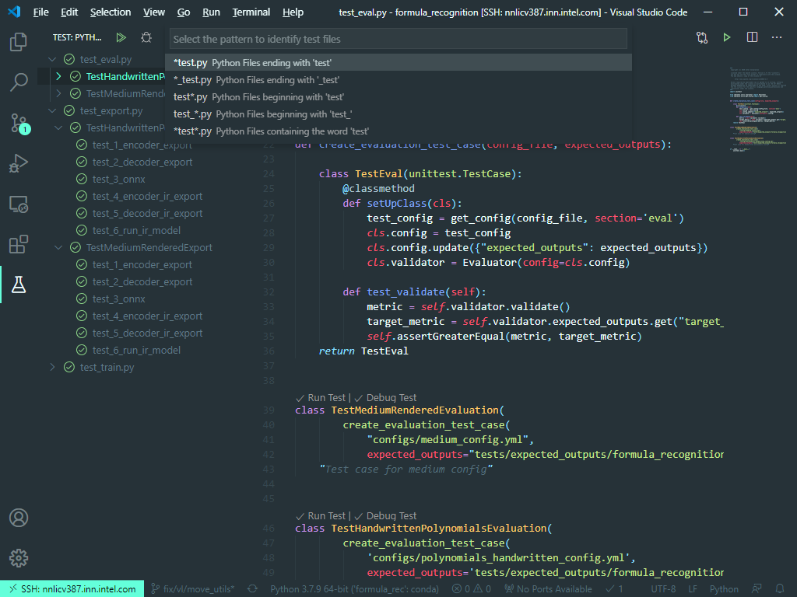
Tests
Tests extension is included to Python extension pack
Supports unittest, pytest, nose
Ability to select tests folder, test file name regexp
Ability to debug tests, run only failed again, run only one, etc
Limitation: tests folder should be on the same level as current opened folder

Slide 23
Debugging

Slide 24
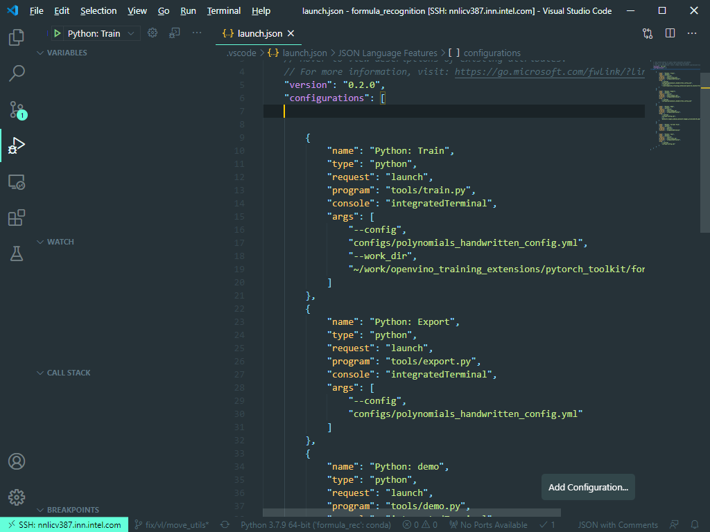
Debugging & debug configs
Standard debugger in Visual Studio Style: breakpoints, watch
Ability to add different configs and switch between them

Slide 25
Code refactoring

Slide 26
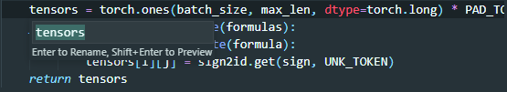
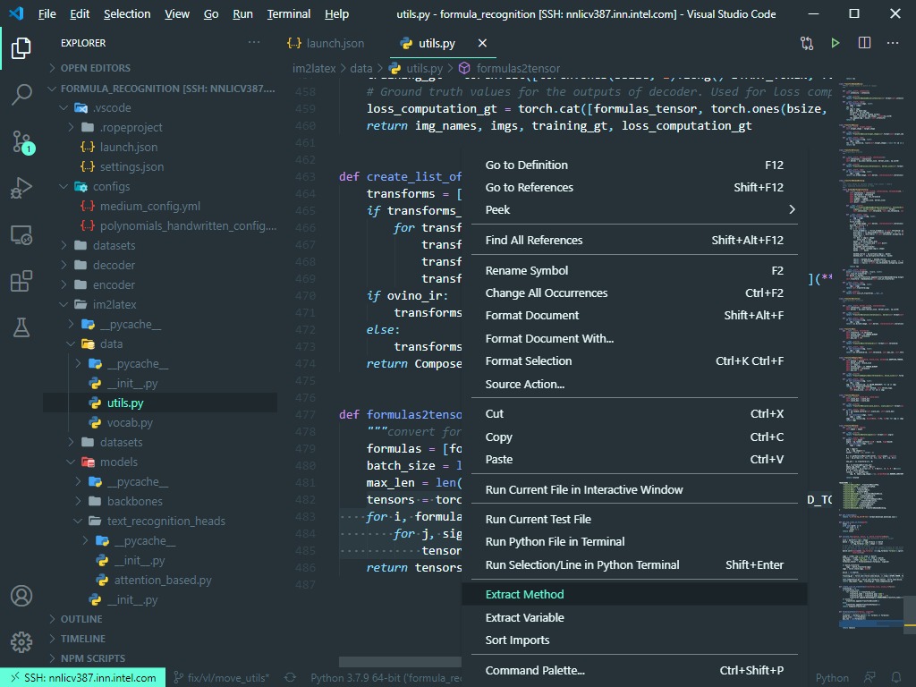
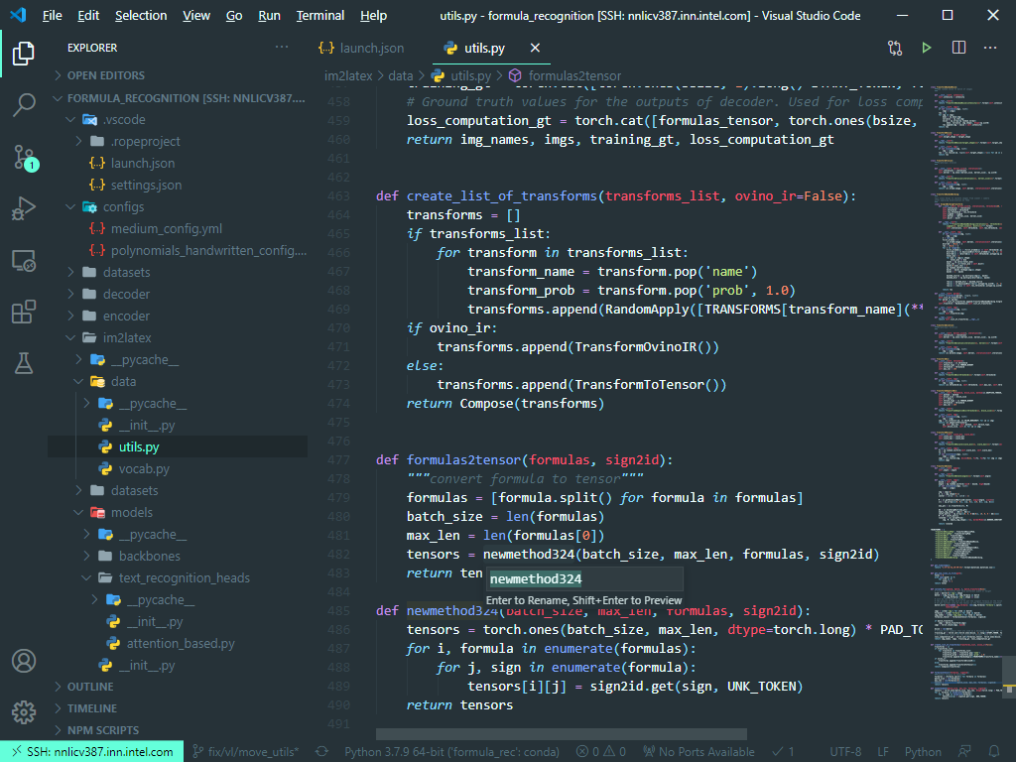
Autoformatting, code refactoring
Shift + alt + F – format document
Ctrl + K Ctrl + F – format selection
F2 – rename variable

Slide 27
Split view

Slide 28
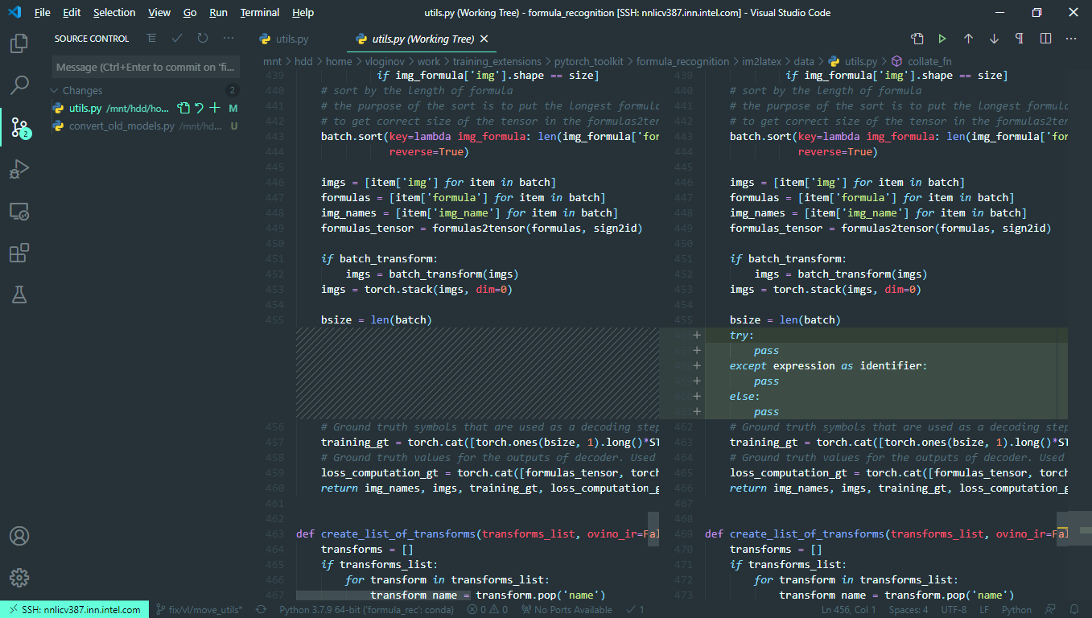
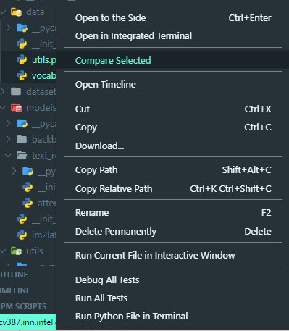
File compare, split view

Slide 29
Zen mode

Slide 30

Zen mode
Ctrl + K Z toggle zen mode
Double Esc quit zen mode
Zen Mode lets you focus on your code by hiding all UI except the editor (no Activity Bar, Status Bar, Sidebar and Panel) and going to full screen

Slide 31
Live-share

Slide 32
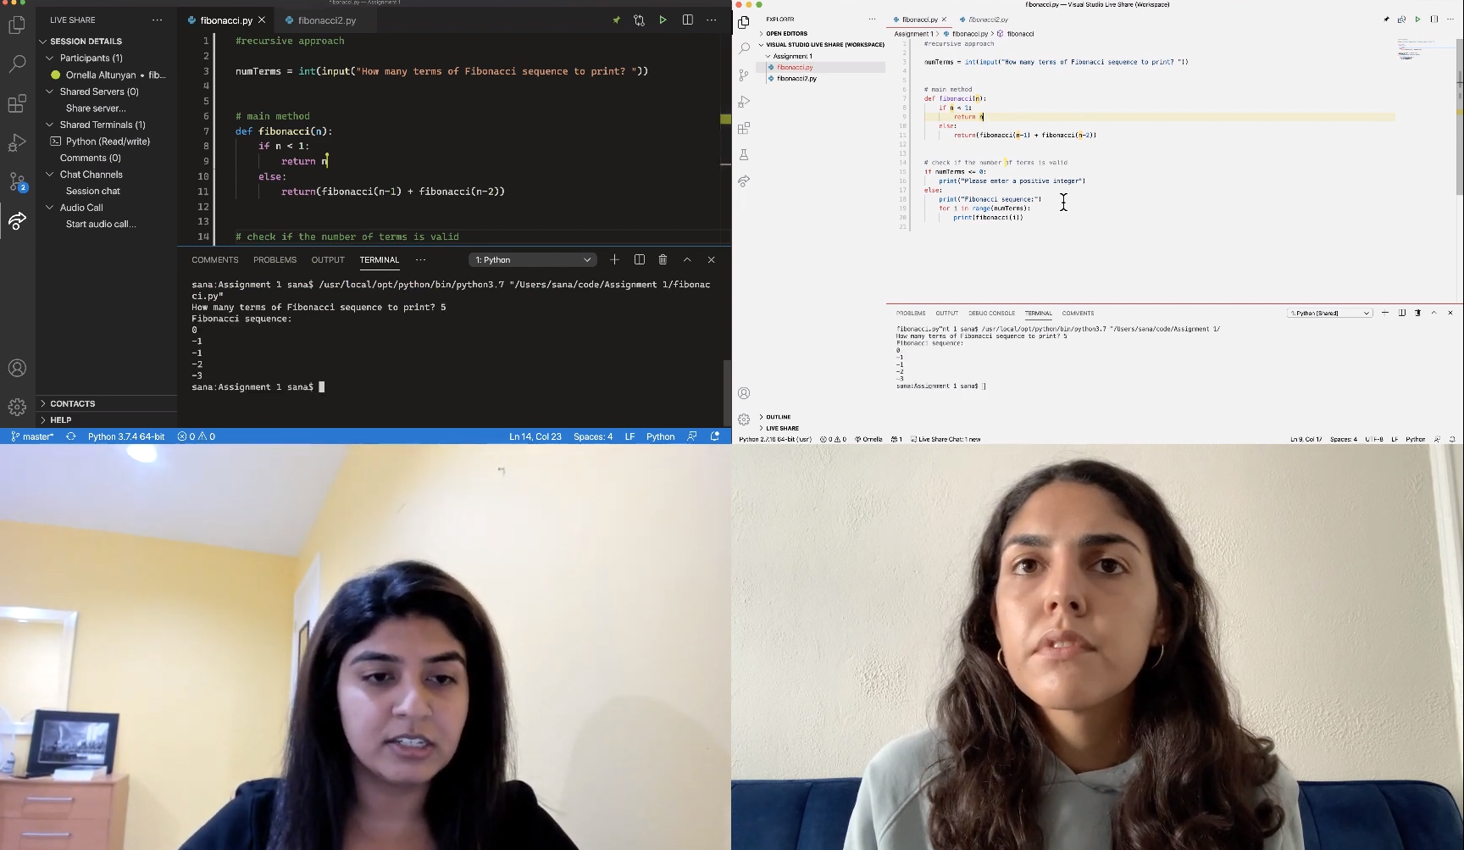
Live-share
Pair programming was never so easy online
Live share allows you to share online code with your colleague for a smooth debugging
Read and write mode, synchronization of the terminal and cursor
https://code.visualstudio.com/learn/collaboration/live-share

Slide 33
Drag and drop extension panels

Slide 34
Pylance

Slide 35
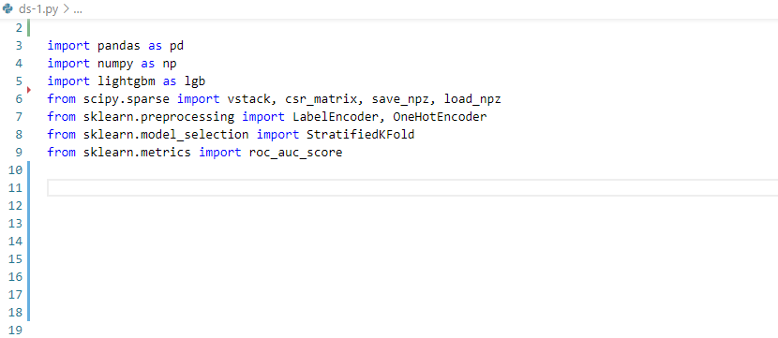
Pylance
Auto imports

Slide 36
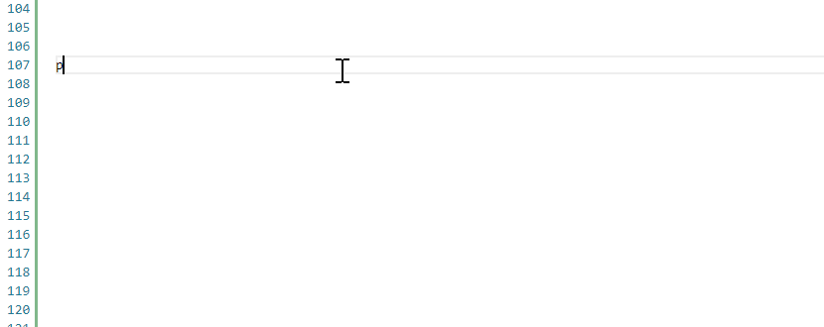
Pylance
Type information

Slide 37
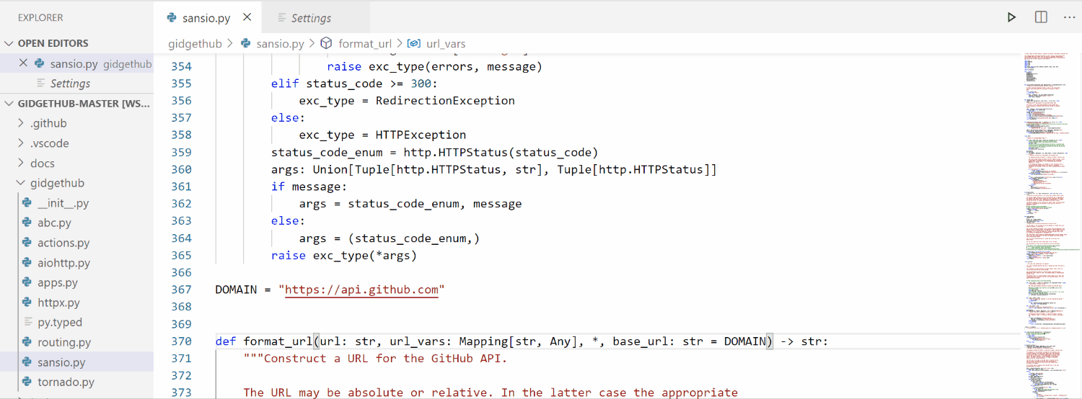
Pylance
Type checking diagnostics

Slide 38
Useful links
https://code.visualstudio.com/docs/getstarted/tips-and-tricks
https://code.visualstudio.com/docs/remote/wsl
https://code.visualstudio.com/docs/remote/ssh
https://code.visualstudio.com/docs/cpp/config-linux

